Slide 1
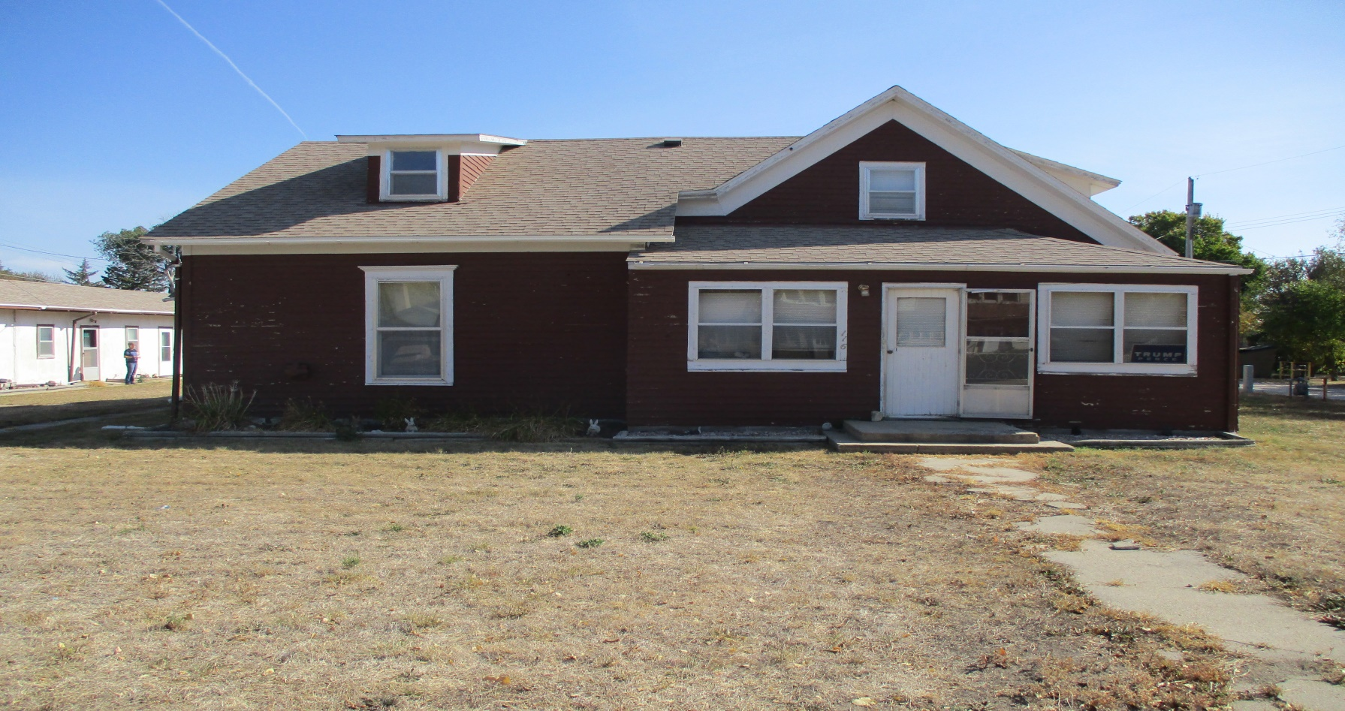
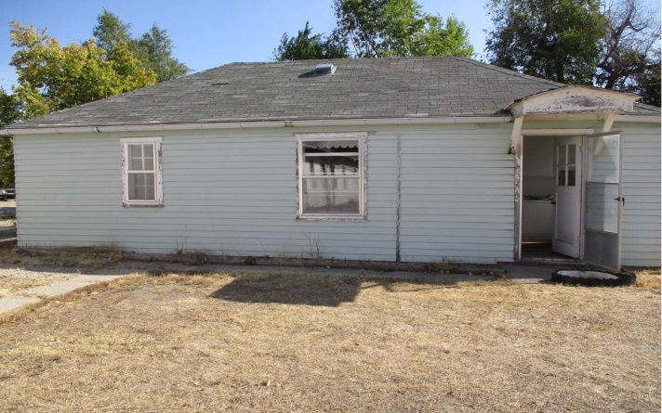
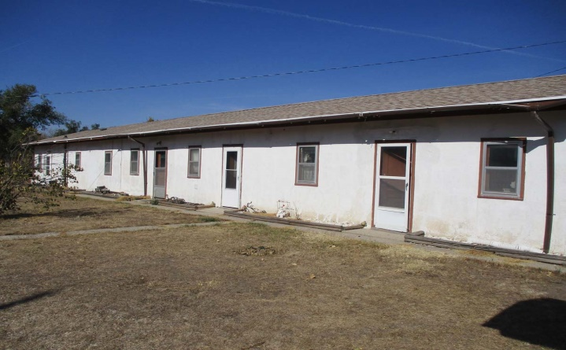
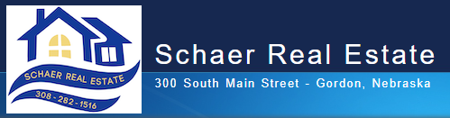
116 Chamberlain Ave Rushville, NE
4+ Bed
2 Bath
2318 sq ft
Call 308-282-1516
$139,900
UNIQUE INCOME PROPERTY!

