Slide 1
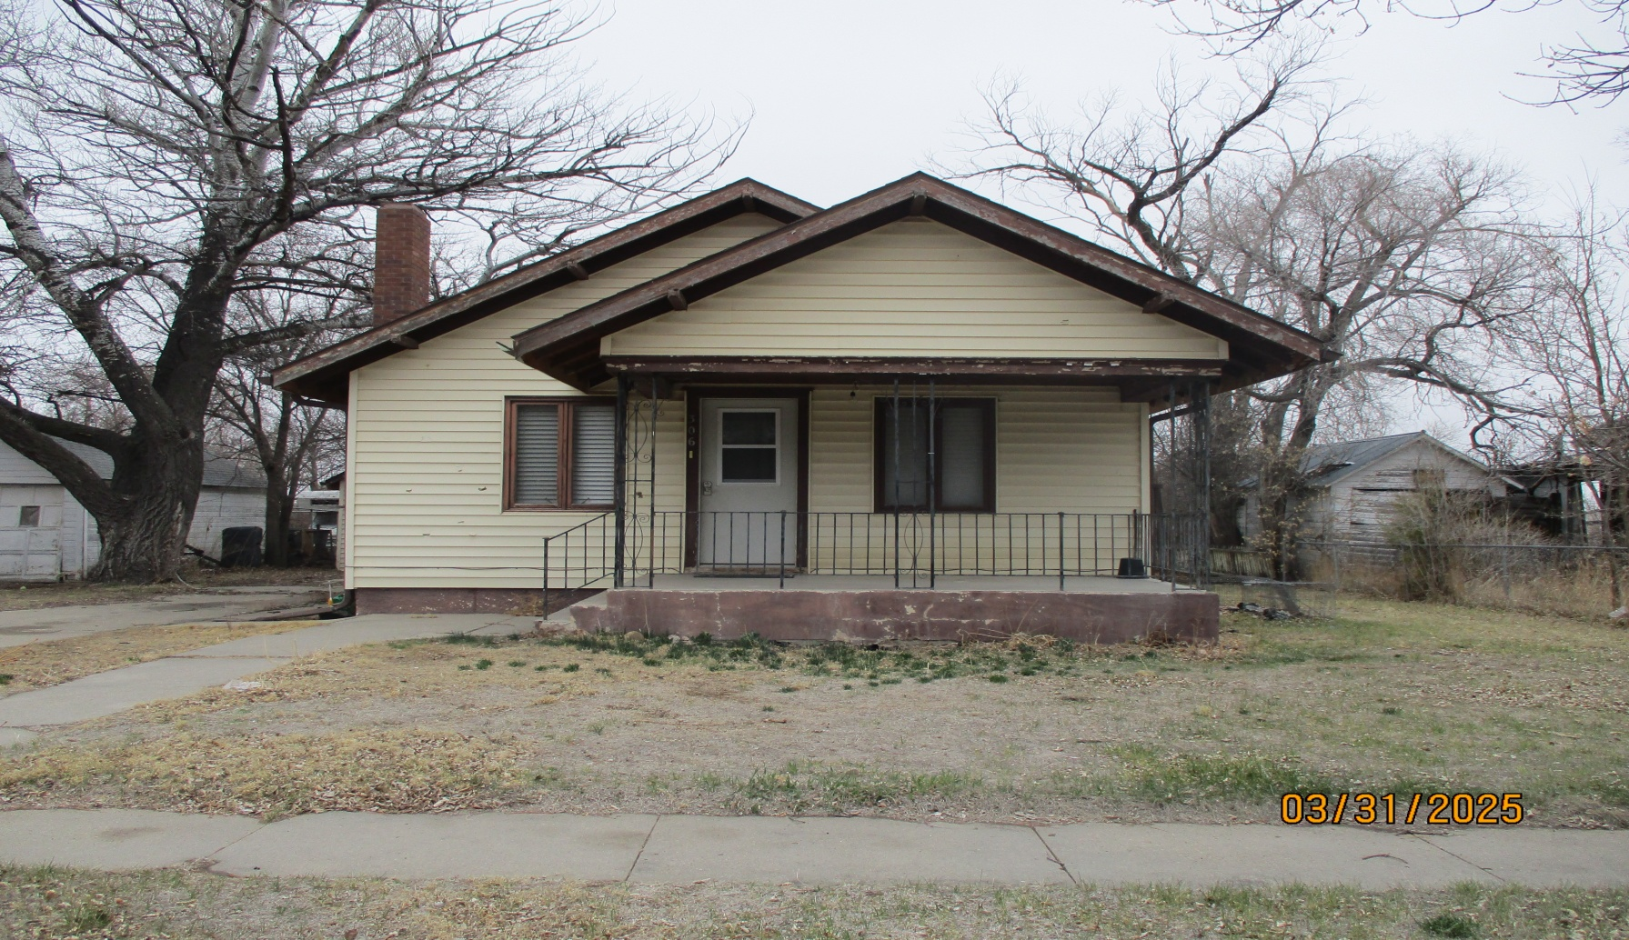
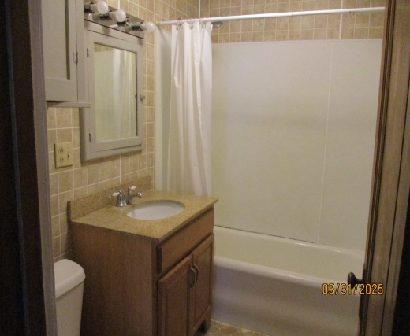
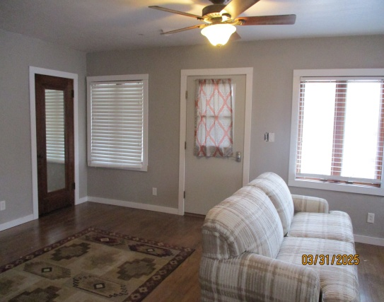
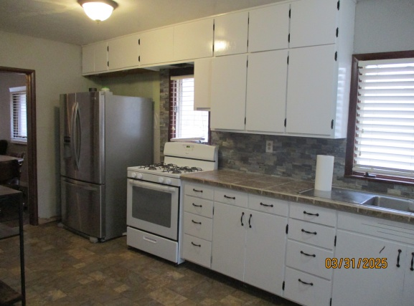

306 Larimer St Rushville, NE
3 Bed
1 Bath
1306 sq ft
Call 308-282-1516
$135,000
Open Floor Plan!

