Slide 1
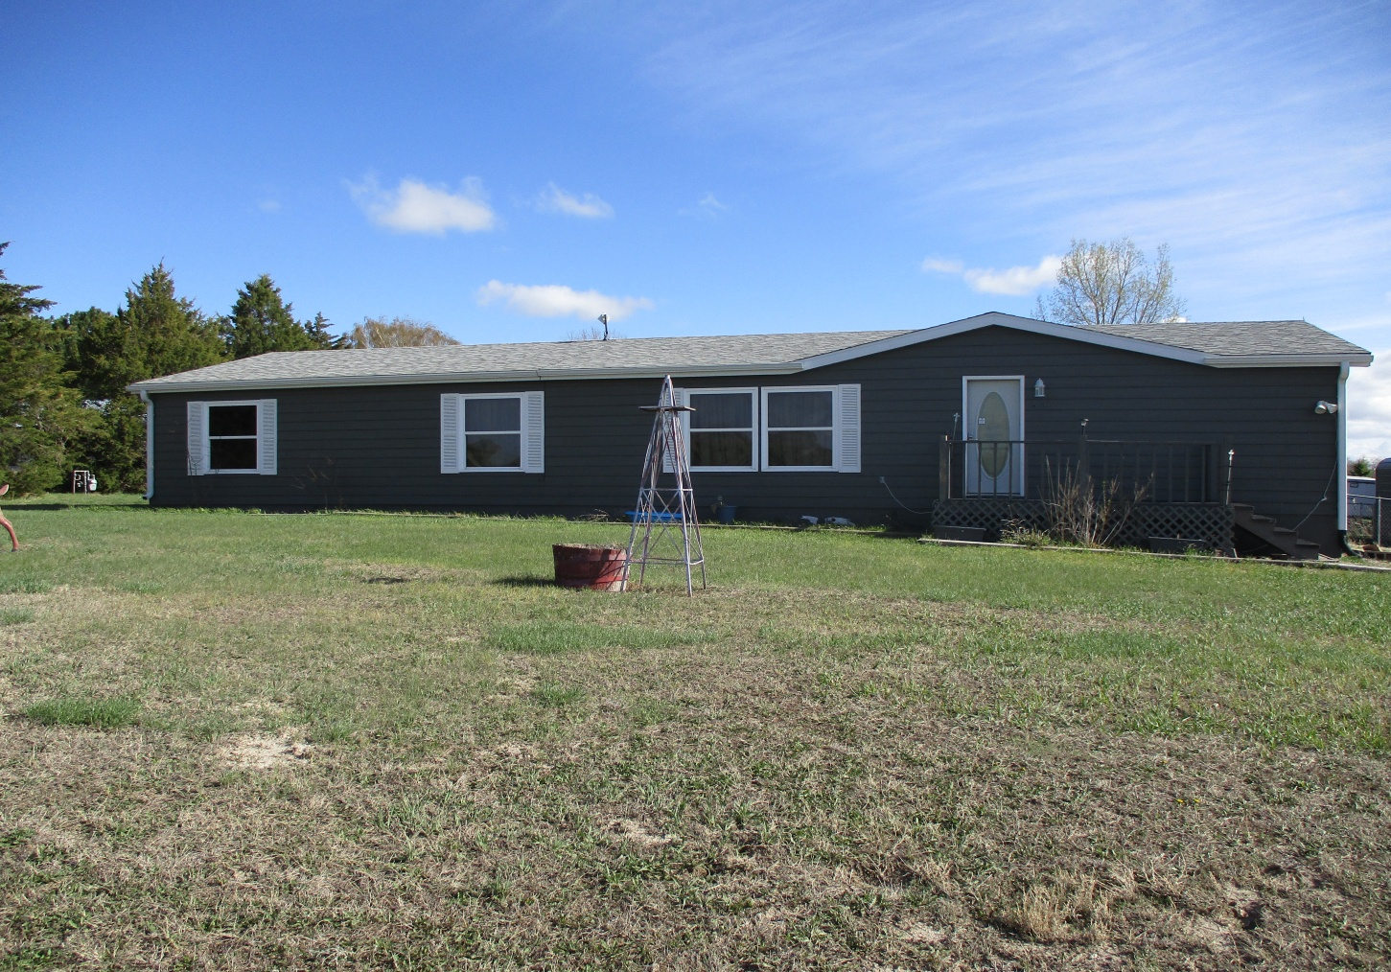

416 W 10th St Gordon NE
3 Bed
2 Bath
1960 sq ft
Call 308-282-1516
$185,000
Updated and Move-In-Ready!

