Slide 1
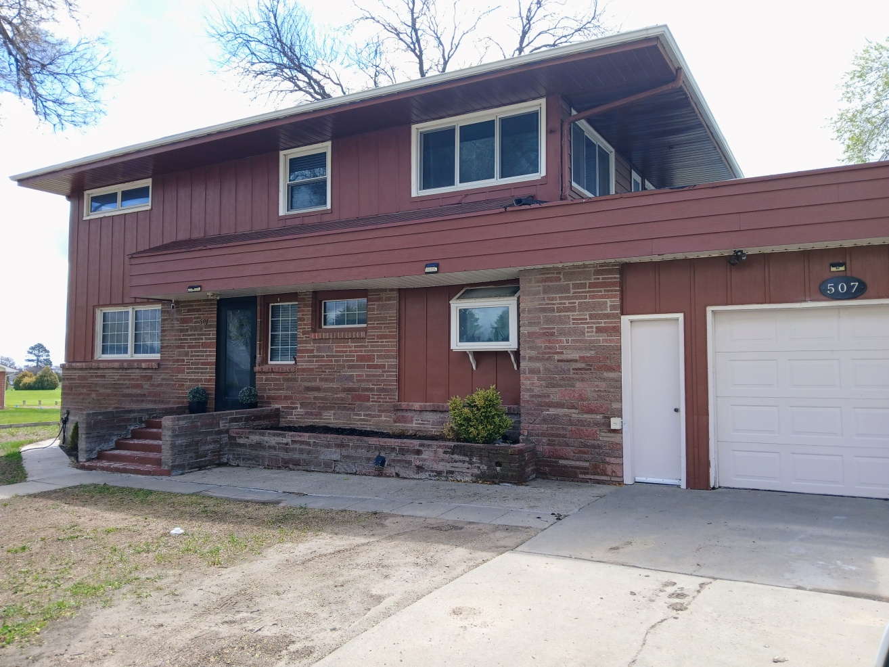
507 E 5th St Gordon NE
4 Bed
2.5 Bath
1946 sq ft
Call 308-282-1516
$285,000
Updated and Move-In-Ready!

